Slide 1
DATA TYPES IN C
Mohamed Rahman Shareff S

Slide 2
DATA TYPES IN C
Data types are used to define the type of data that a variable can store and the operations that can be performed on those data.
ANSI C provides three types of data-types.
Primary Data Types
Derived Data Type
User Defined Data Types

Slide 3
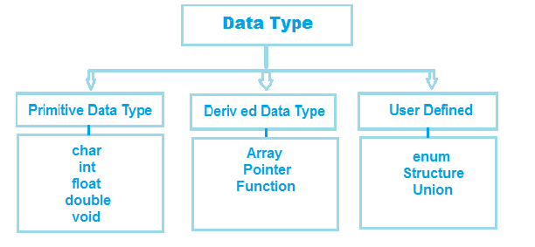
DATA TYPES IN C

Slide 4
1. Primitive Data types in C

Slide 5
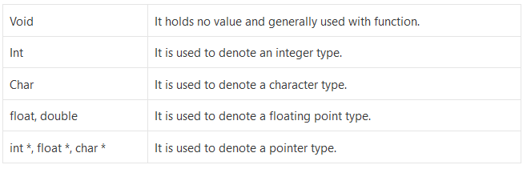
Primitive Data types in C
Primitive types are also known as pre-defined or basic data types.

Slide 6
1. Integer Data type
Integers are numbers without decimal point
Integers are whole numbers with a range of values, range of values are machine dependent.
Generally an integer occupies 2 bytes memory space and its value range limited to -n32768 to +32767 (that is, -215 to +215-1).
A signed integer use one bit for storing sign and rest 15 bits for number.

Slide 7
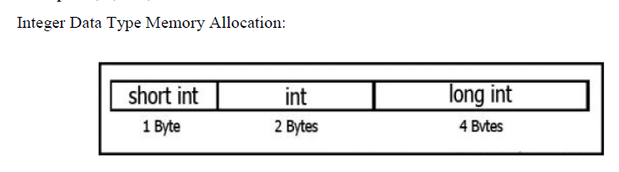
Integer Data types
To control the range of numbers and storage space, C has three classes of integer storage namely
short int,
int and
long int.
All three data types have signed and unsigned forms.
A short int requires half the amount of storage than normal integer.
Unlike signed integer, unsigned integers are always positive and use all the bits for the magnitude of the number.
Therefore, the range of an unsigned integer will be from 0 to 65535.

Slide 8
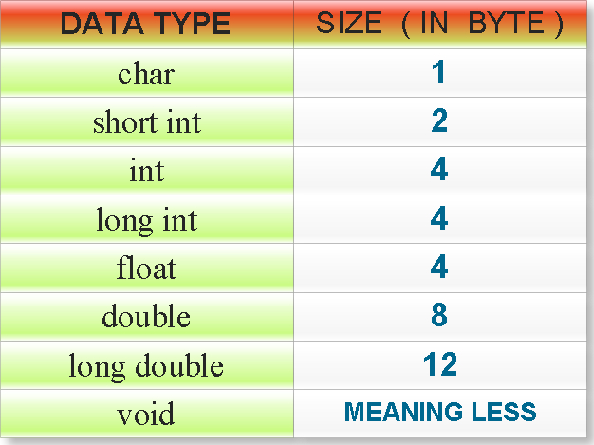
The long integers are used to declare a longer range of values and it occupies 4 bytes of storage space.
Syntax: int <variable name>;
Examples:
int num1;
short int num2;
long int num3;

Slide 9
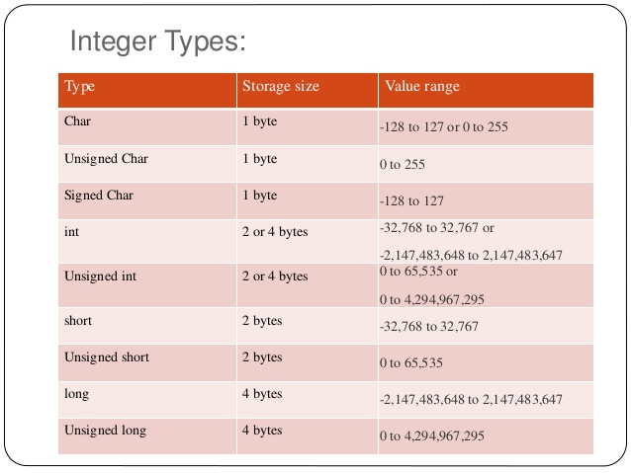

Slide 10
2. Floating point Datatype
The float data type is used to store fractional numbers (real numbers) with 6 digits of precision.
Floating point numbers are denoted by the keyword float. When the accuracy of the floating point number is insufficient, we can use the double to define the number.
The double is same as float but with longer precision and takes double space (8 bytes) than float.
To extend the precision further we can use long double which occupies 10 bytes of memory space.

Slide 11
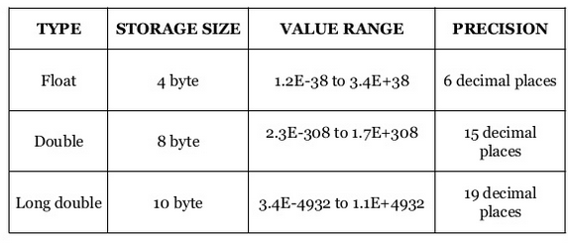
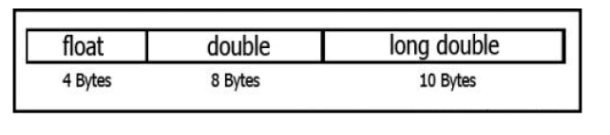
Floating point Datatype
Syntax:
float <variable name>;
Example: float num1;
double num2;
long double num3;
Floating Point Data Type Memory Allocation:

Slide 12
3. Character Data Type
Character type variable can hold a single character
Declared by using the keyword char.
As there are signed and unsigned int (either short or long), in the same way there are signed and unsigned chars; both occupy 1 byte each, but having different ranges.
Unsigned characters have values between 0 and 255, signed characters have values from –128 to 127.
Syntax: char <variable name>;

Slide 13
4. TYPE VOID DATA TYPE
The void type has no values.
Used with function to specify its type.
Example: If "main ()" is defined as void type means it does not return any value.

Slide 14
2. DERIVED DATA TYPE

Slide 15
DERIVED DATA TYPE
Derived from fundamental data type.
Variable of derived data type allows us to store the value of the same type in one variable.
C supports three derived data types:
Array: Arrays are sequences of data items that have homogeneous values and adjacent memory locations to store values.a
Pointer: It is used to access memory and deal with their addresses.
Function: is a set of executable statements to perform a task.

Slide 16
3. USER DEFINED DATATYPE

Slide 17
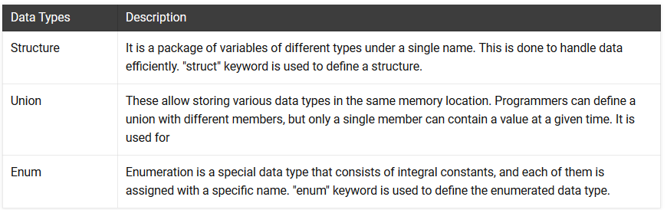
USER DEFINED DATATYPE
These datatypes are defined by the user.

